Slide 1
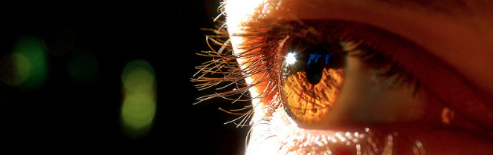
Reconocimiento de Patrones
Domingo Mery
Departmento de Ciencia de la Computación
Escuela de Ingeniería
Universidad Católica de Chile
Feature Extraction 1D
[ Capítulo 2 ]

Slide 2
0. Transforms
PAT02_FX_1D.pptx

Slide 3
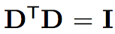
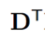
General Linear Transformation: Traditional Dictionaries
y
x
n
K ≤ n
y
y = Dx
x
There are many known Dictionaries:
Name | Size | Type
Fourier | K = n | Fixed
Haar | K = n | Fixed
DCT | K = n | Fixed
Wavelets | K = n | Fixed
Gabor | K = n | Fixed
PCA | K ≤ n | Learned
Properties:
x = y
+ Sparse Representations

Slide 4
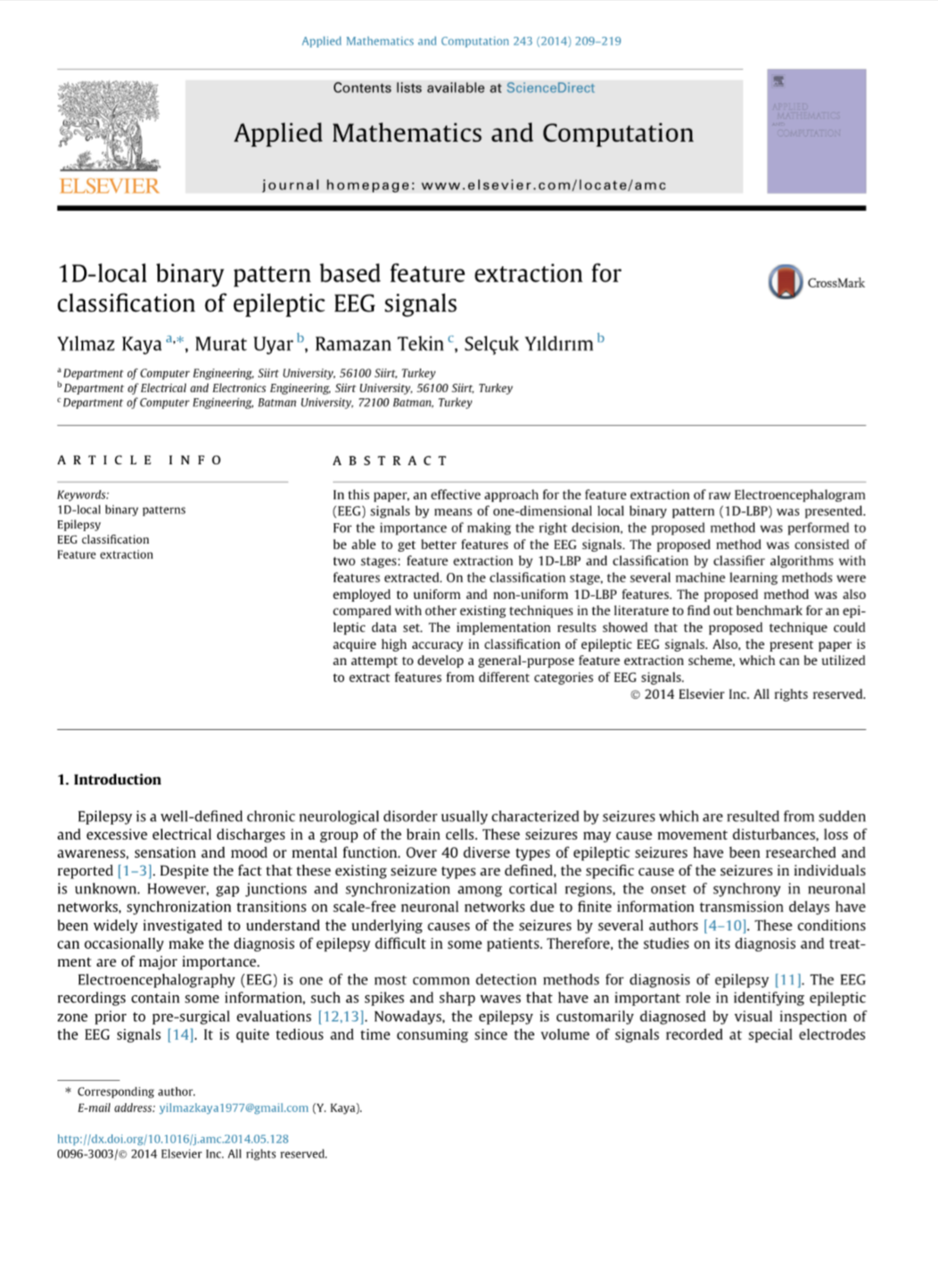
1. LBP-1D
Kaya, Y., Uyar, M., Tekin, R., & Yıldırım, S. (2014). 1D-local binary pattern based feature extraction for classification of epileptic EEG signals. Applied Mathematics and Computation, 243, 209-219.
PAT02_FX_1D.pptx

Slide 5
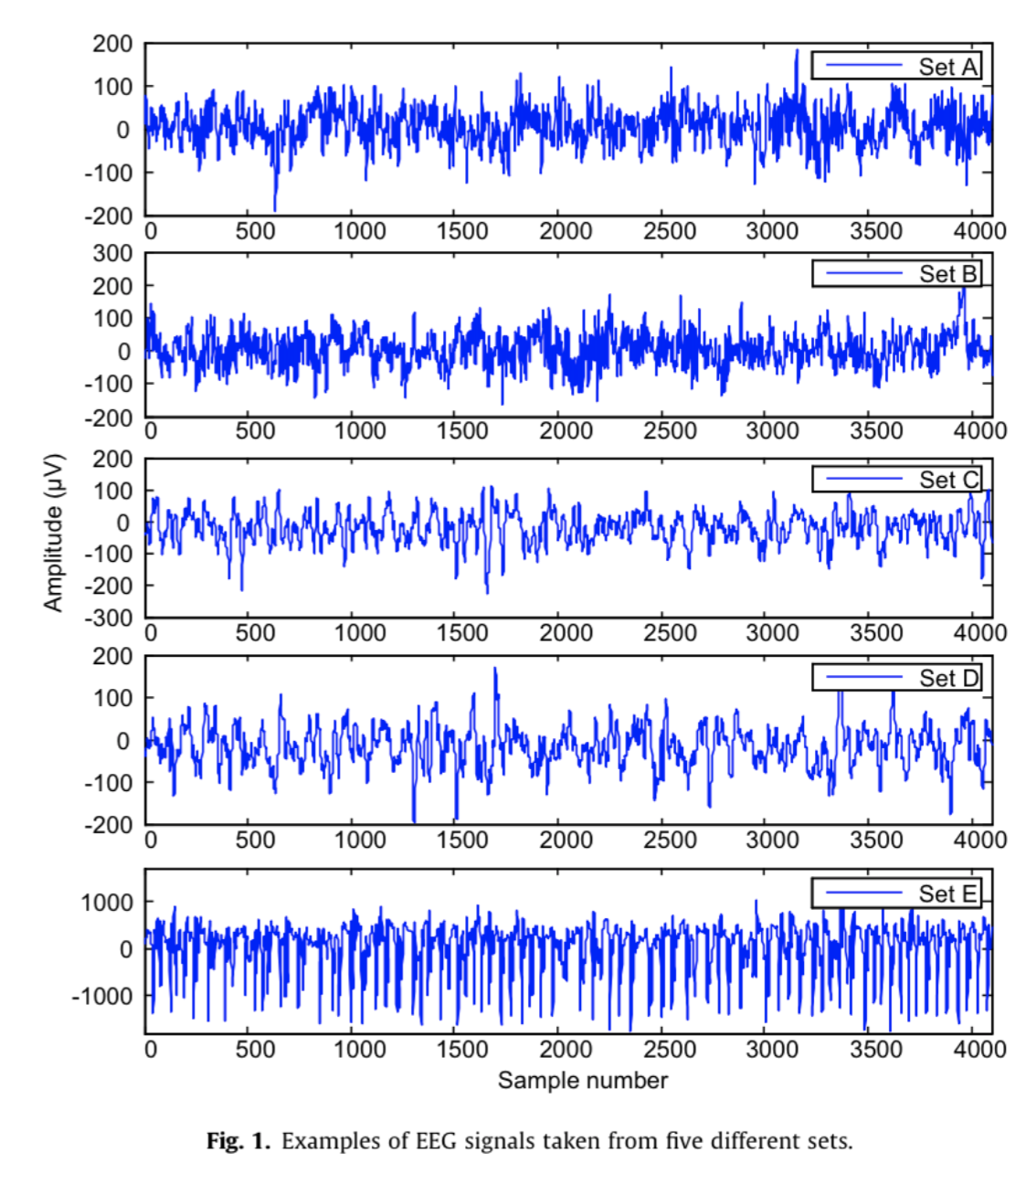
EEG Signals
PAT02_FX_1D.pptx

Slide 6
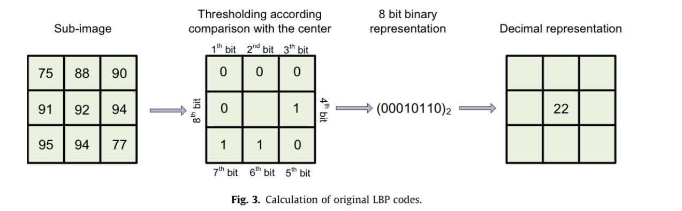
LBP 2D
PAT02_FX_1D.pptx

Slide 7
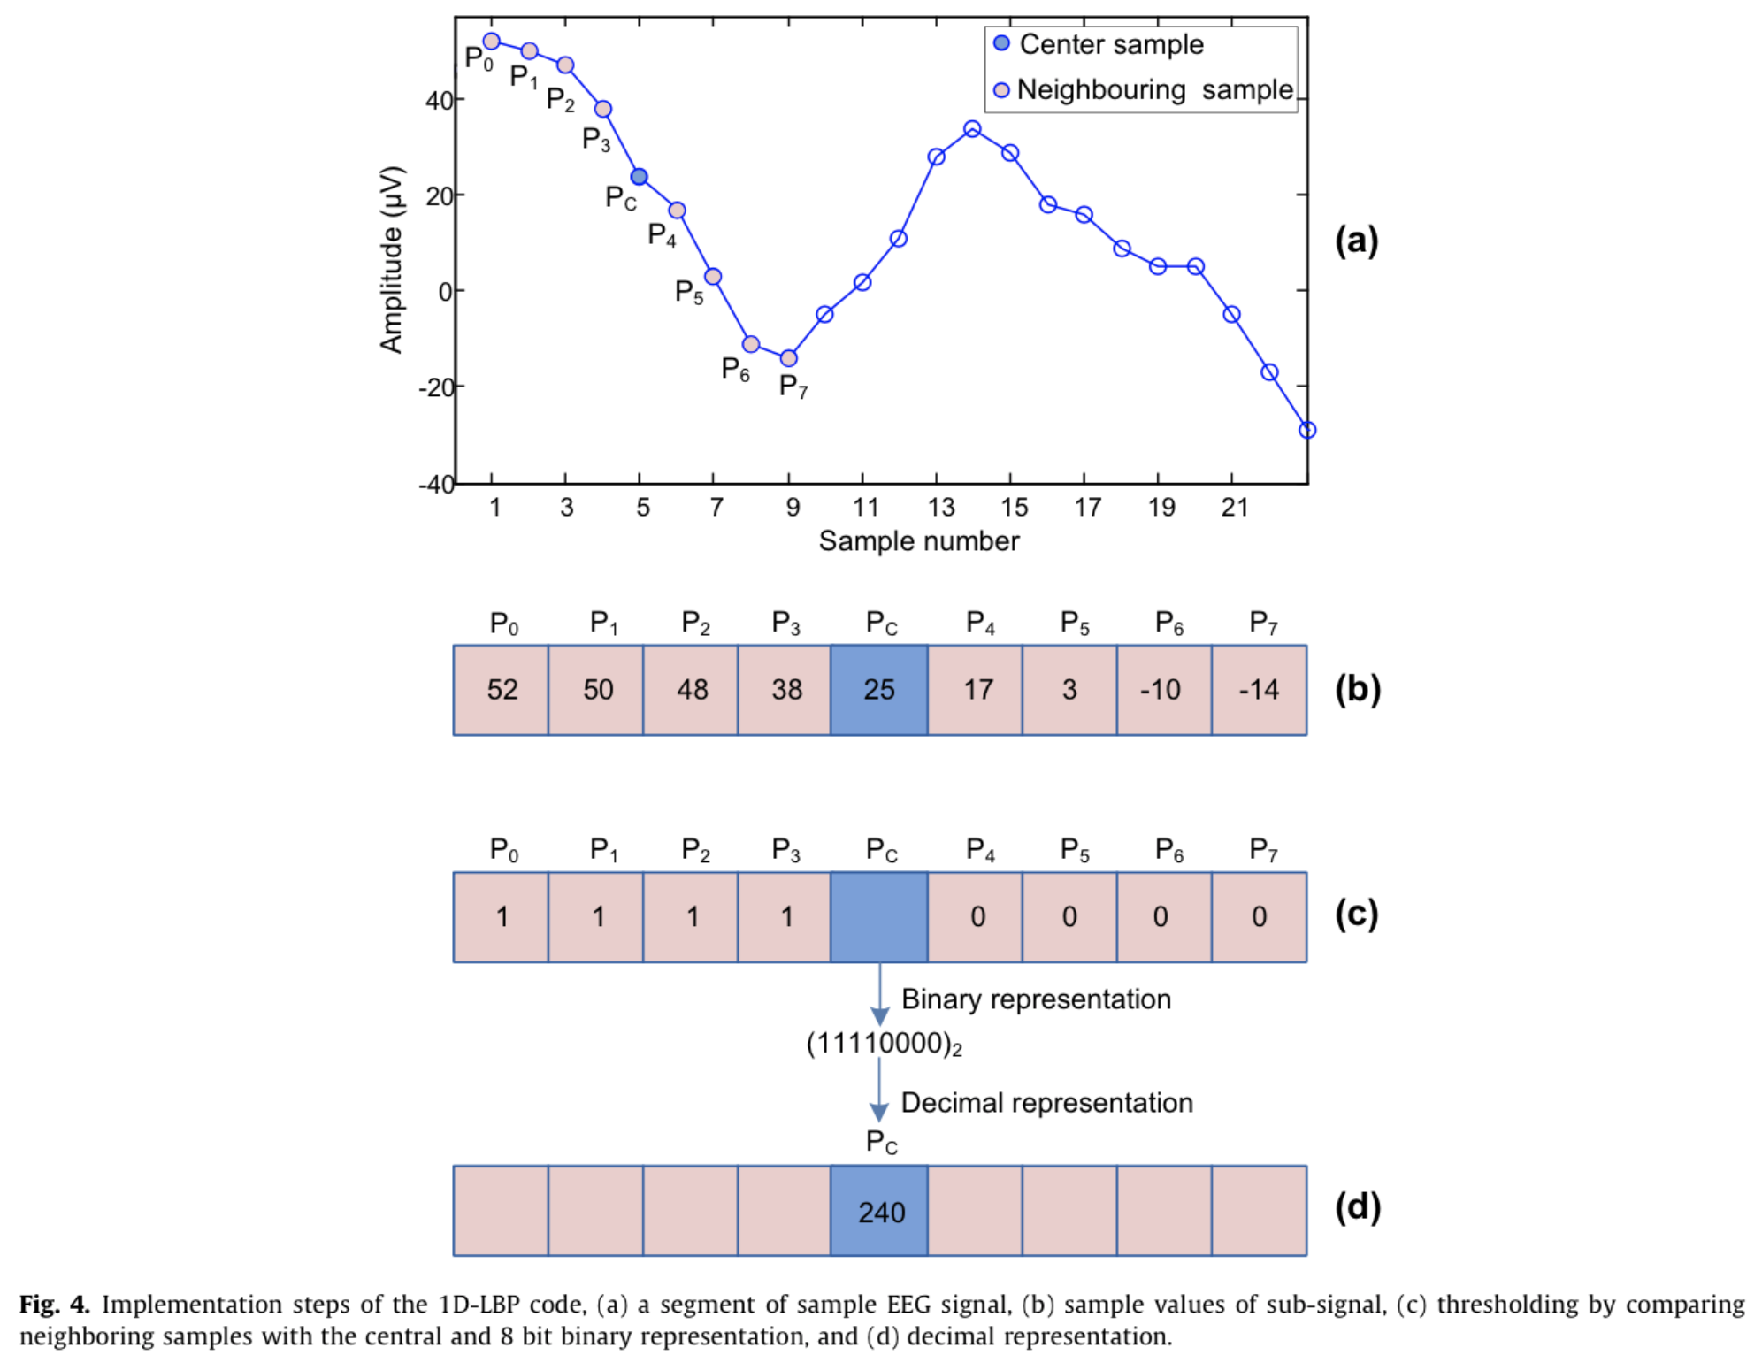
LBP 2D
PAT02_FX_1D.pptx

Slide 8
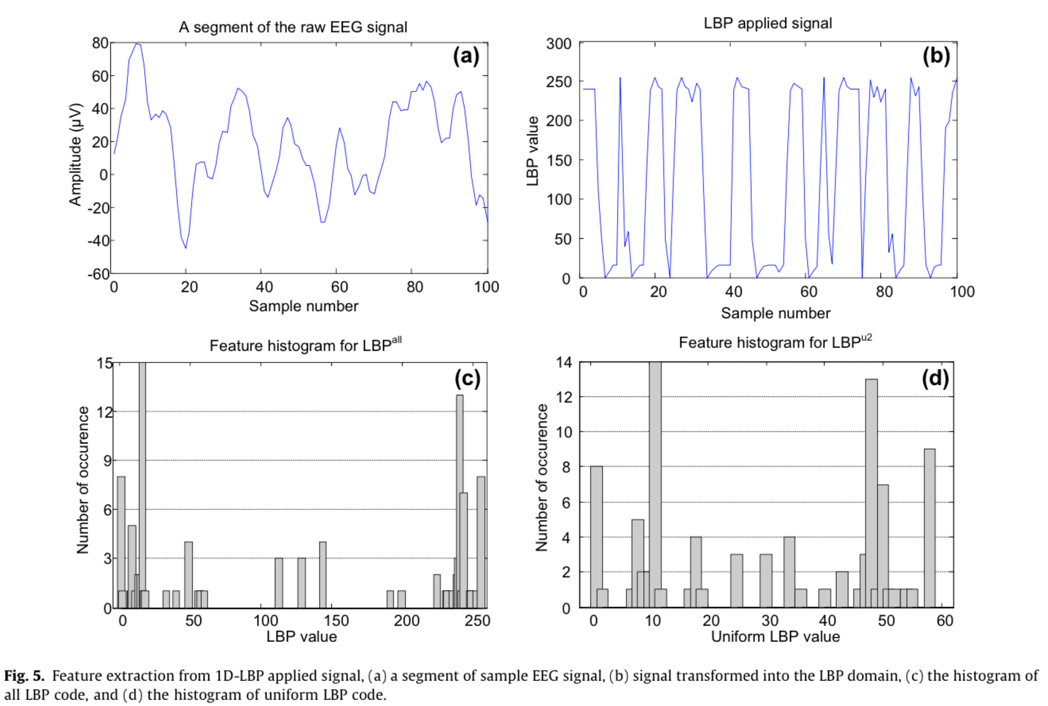
PAT02_FX_1D.pptx

Slide 9
2. Music Features
https://towardsdatascience.com/extract-features-of-music-75a3f9bc265d
Music Feature Extraction in Python
Different type of audio features and how to extract them.
By Sanket Doshi
https://towardsdatascience.com/understanding-audio-data-fourier-transform-fft-spectrogram-and-speech-recognition-a4072d228520
Understanding Audio data, Fourier Transform, FFT and Spectrogram features for a Speech Recognition System
By Kartik Chaudhary
https://medium.com/tencent-thailand/music-information-retrieval-part-1-using-librosa-to-extract-audio-features-6e8569537185
Using LibROSA to extract audio features
By KK GG
PAT02_FX_1D.pptx

Slide 10
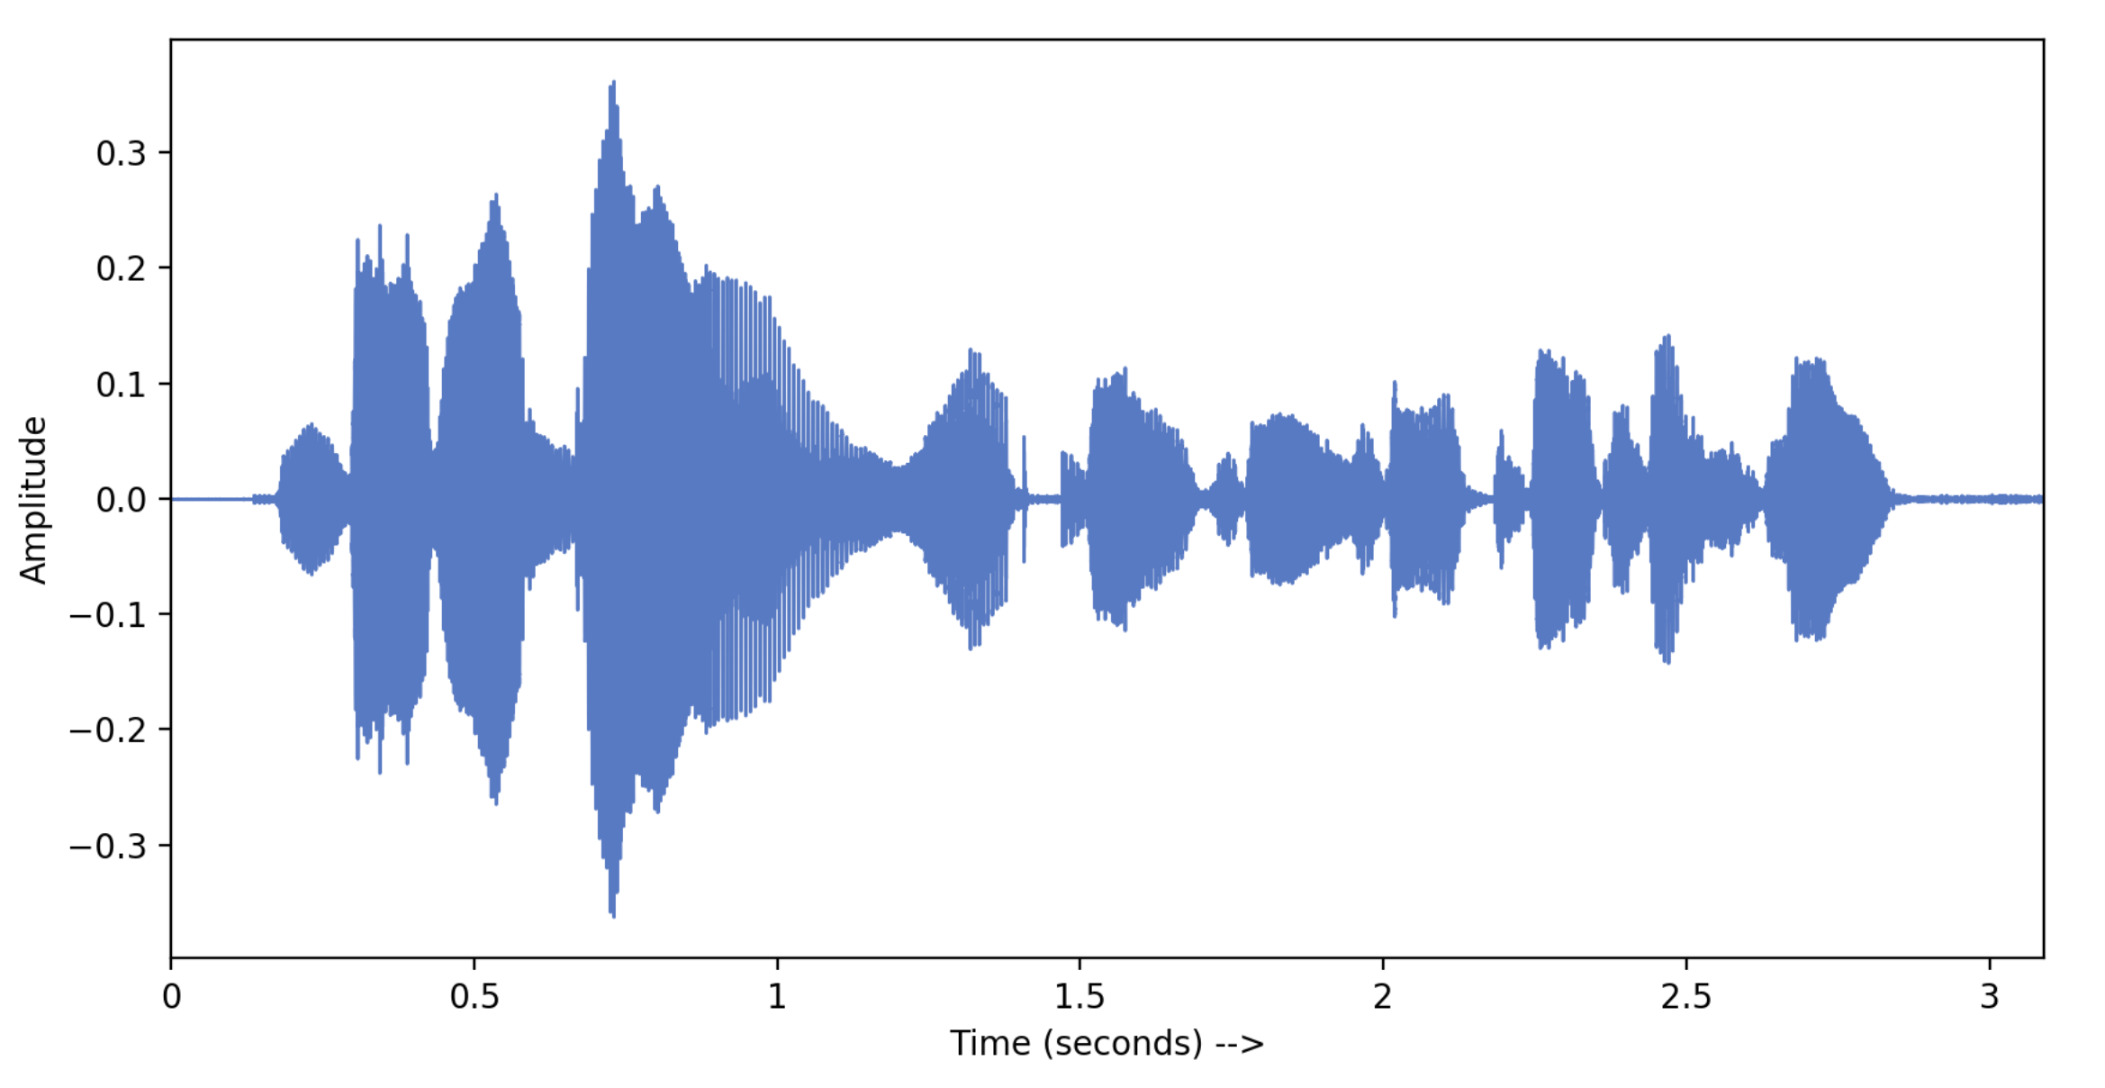
Audio signal in time domain
PAT02_FX_1D.pptx

Slide 11
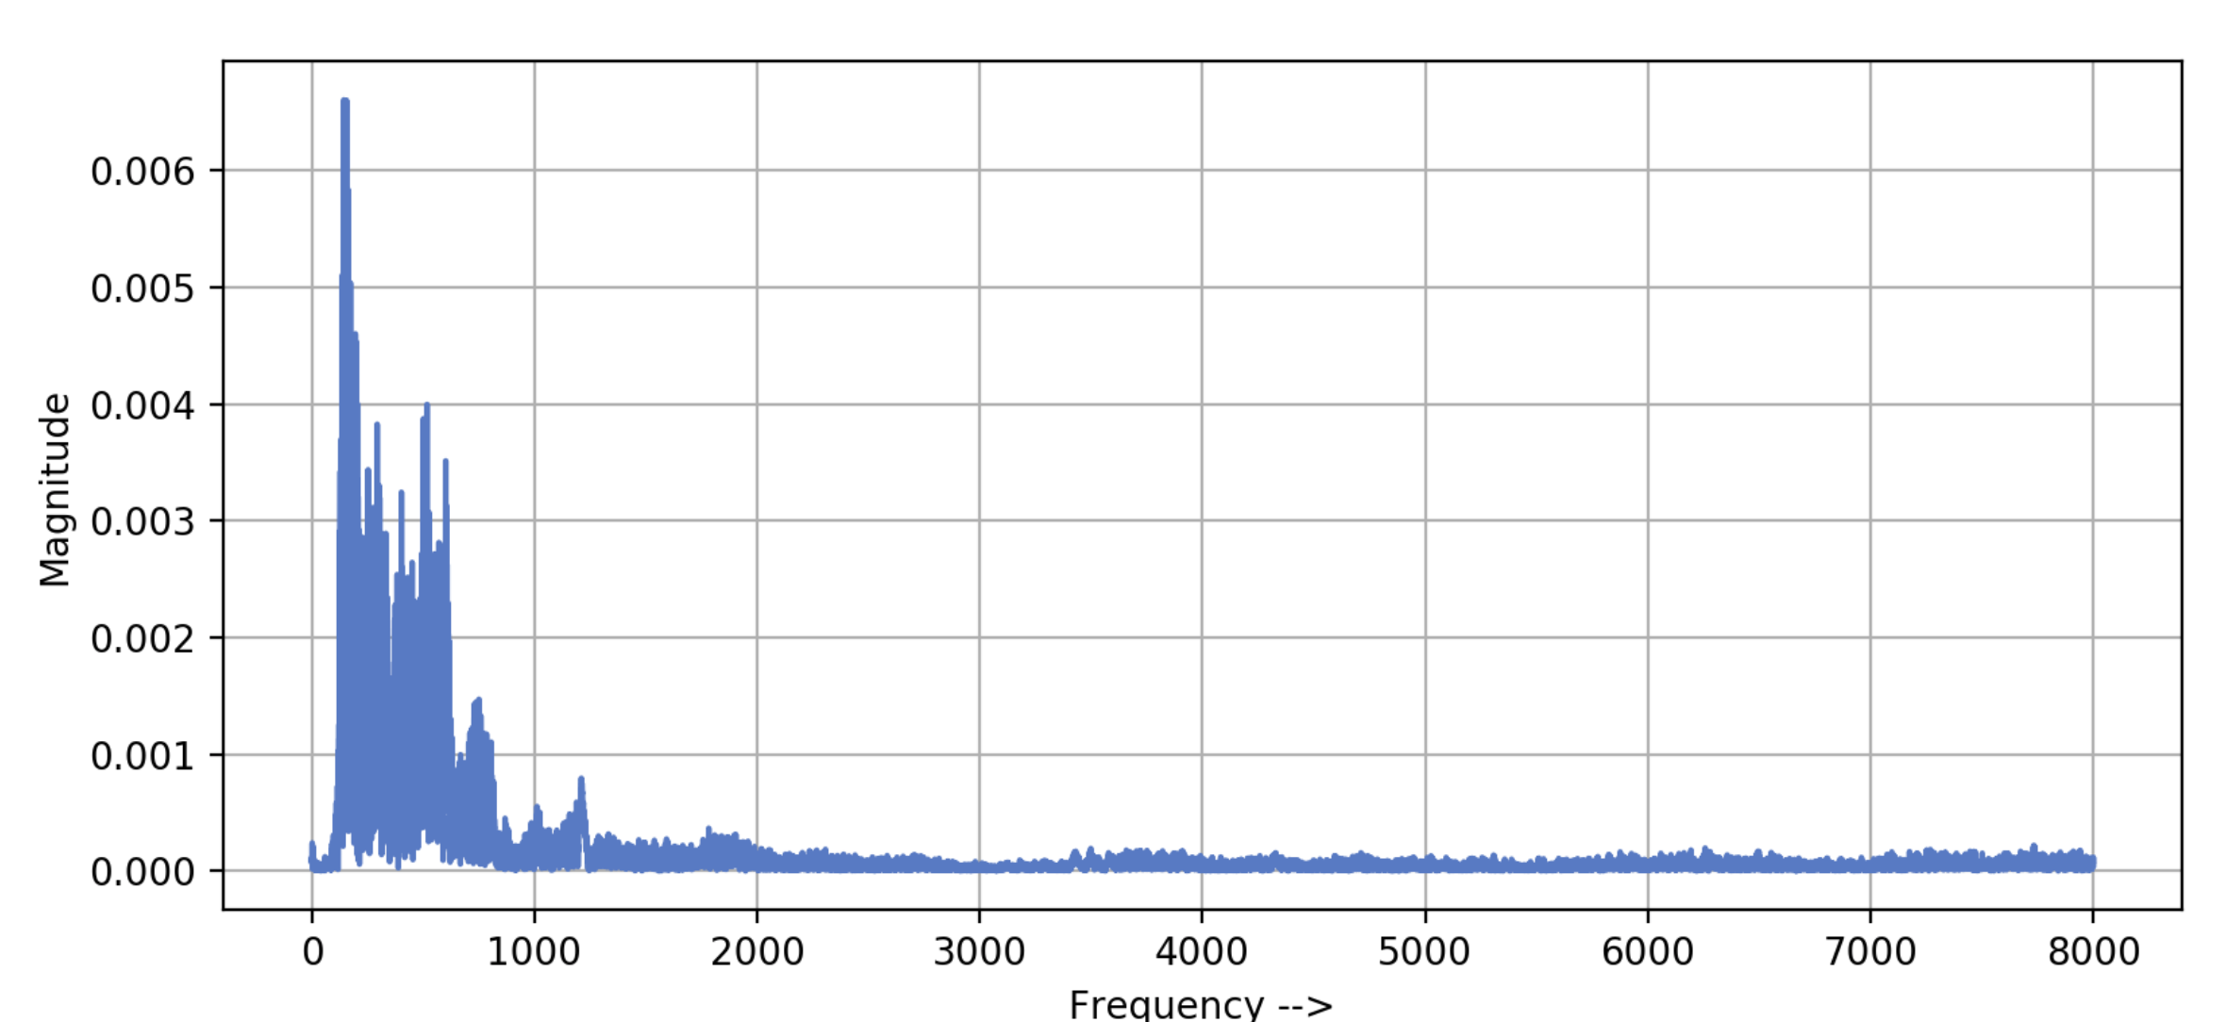
Audio signal in frequency domain
PAT02_FX_1D.pptx

Slide 12
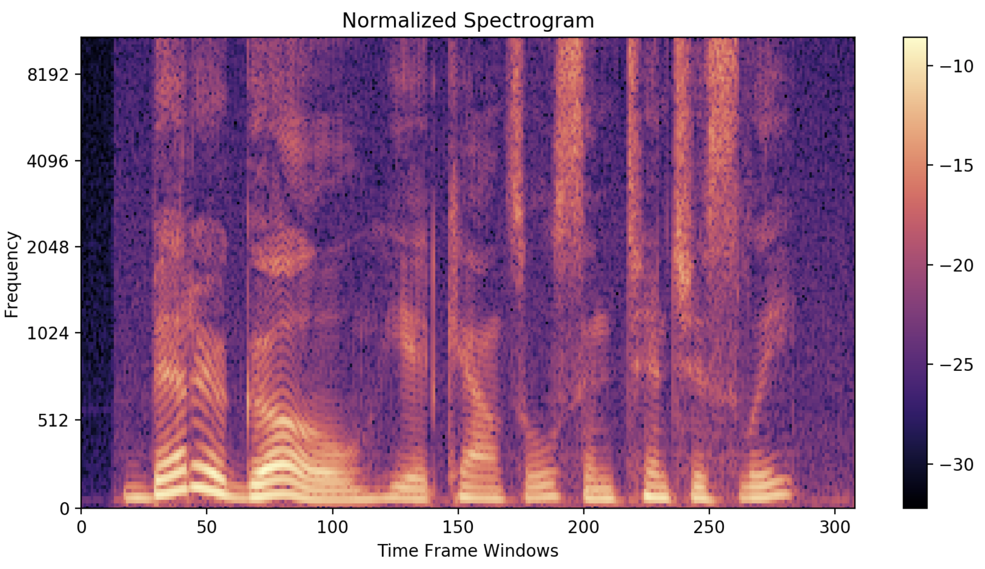
PAT02_FX_1D.pptx

Slide 13
Some features
Zero Crossing Rate
The zero crossing rate is the rate of sign-changes along a signal, i.e., the rate at which the signal changes from positive to negative or back. This feature has been used heavily in both speech recognition and music information retrieval. It usually has higher values for highly percussive sounds like those in metal and rock.
Spectral Centroid
It indicates where the ”centre of mass” for a sound is located and is calculated as the weighted mean of the frequencies present in the sound. If the frequencies in music are same throughout then spectral centroid would be around a centre and if there are high frequencies at the end of sound then the centroid would be towards its end.
Spectral Rolloff
Spectral rolloff is the frequency below which a specified percentage of the total spectral energy, e.g. 85%, lies.
PAT02_FX_1D.pptx

Slide 14
Mel Scale
The mel scale, named by Stevens, Volkmann, and Newman in 1937,[1] is a perceptual scale of pitches judged by listeners to be equal in distance from one another. The reference point between this scale and normal frequency measurement is defined by assigning a perceptual pitch of 1000 mels to a 1000 Hz tone, 40 dB above the listener's threshold. Above about 500 Hz, increasingly large intervals are judged by listeners to produce equal pitch increments. As a result, four octaves on the hertz scale above 500 Hz are judged to comprise about two octaves on the mel scale. The name mel comes from the word melody to indicate that the scale is based on pitch comparisons.
PAT02_FX_1D.pptx

Slide 15
Mel-frequency cepstrum (MFC)
In sound processing, the mel-frequency cepstrum (MFC) is a representation of the short-term power spectrum of a sound, based on a linear cosine transform of a log power spectrum on a nonlinear mel scale of frequency.
Mel-frequency cepstral coefficients (MFCCs) are coefficients that collectively make up an MFC.[1] They are derived from a type of cepstral representation of the audio clip (a nonlinear "spectrum-of-a-spectrum"). The difference between the cepstrum and the mel-frequency cepstrum is that in the MFC, the frequency bands are equally spaced on the mel scale, which approximates the human auditory system's response more closely than the linearly-spaced frequency bands used in the normal cepstrum. This frequency warping can allow for better representation of sound, for example, in audio compression.
MFCCs are commonly derived as follows:[2]
Take the Fourier transform of (a windowed excerpt of) a signal.
Map the powers of the spectrum obtained above onto the mel scale, using triangular overlapping windows.
Take the logs of the powers at each of the mel frequencies.
Take the discrete cosine transform of the list of mel log powers, as if it were a signal.
The MFCCs are the amplitudes of the resulting spectrum.
PAT02_FX_1D.pptx

Slide 16
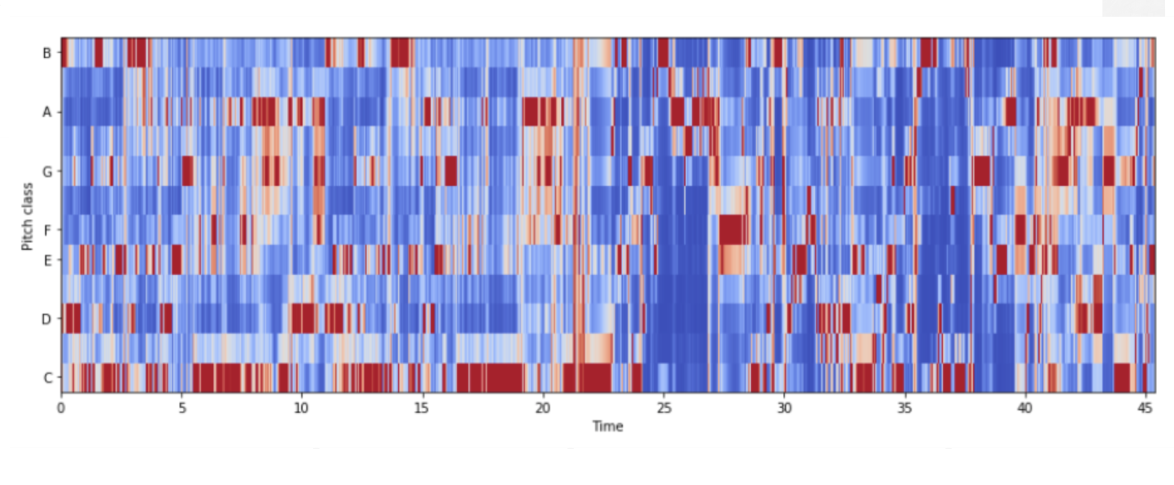
Mel-frequency cepstrum (MFC)
PAT02_FX_1D.pptx

Slide 17
3. Mechanical Signals
https://la.mathworks.com/help/predmaint/ug/Rolling-Element-Bearing-Fault-Diagnosis.html
Rolling Element Bearing Fault Diagnosis
By MathWorks
Antoni, J. (2006). The spectral kurtosis: a useful tool for characterising non-stationary signals. Mechanical systems and signal processing, 20(2), 282-307.
PAT02_FX_1D.pptx

Slide 18
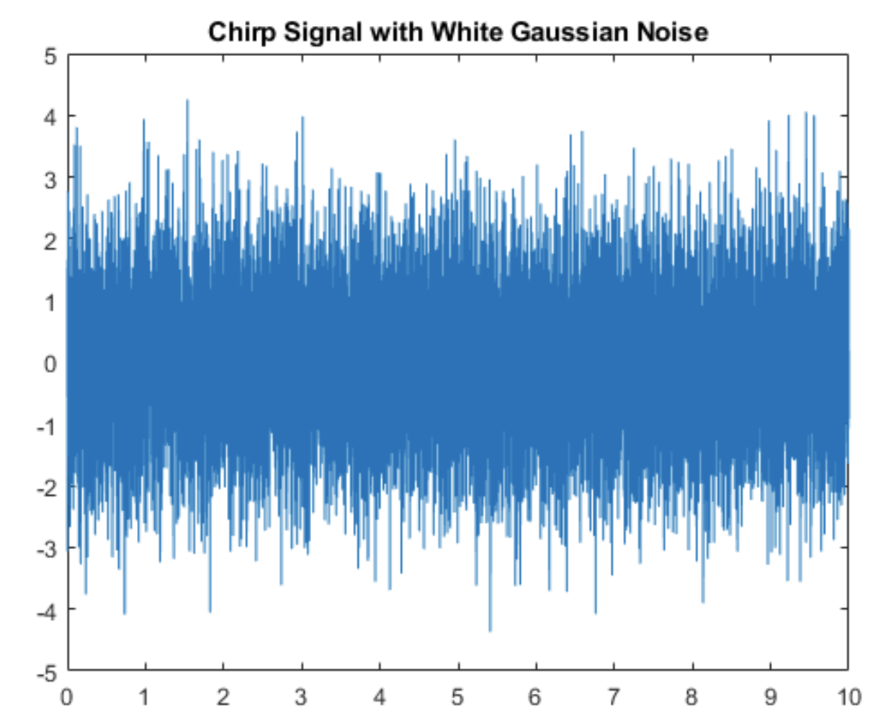
PAT02_FX_1D.pptx

Slide 19
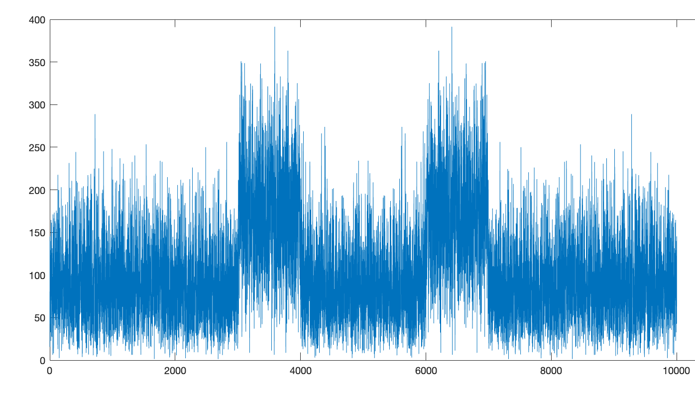
FFT
PAT02_FX_1D.pptx

Slide 20
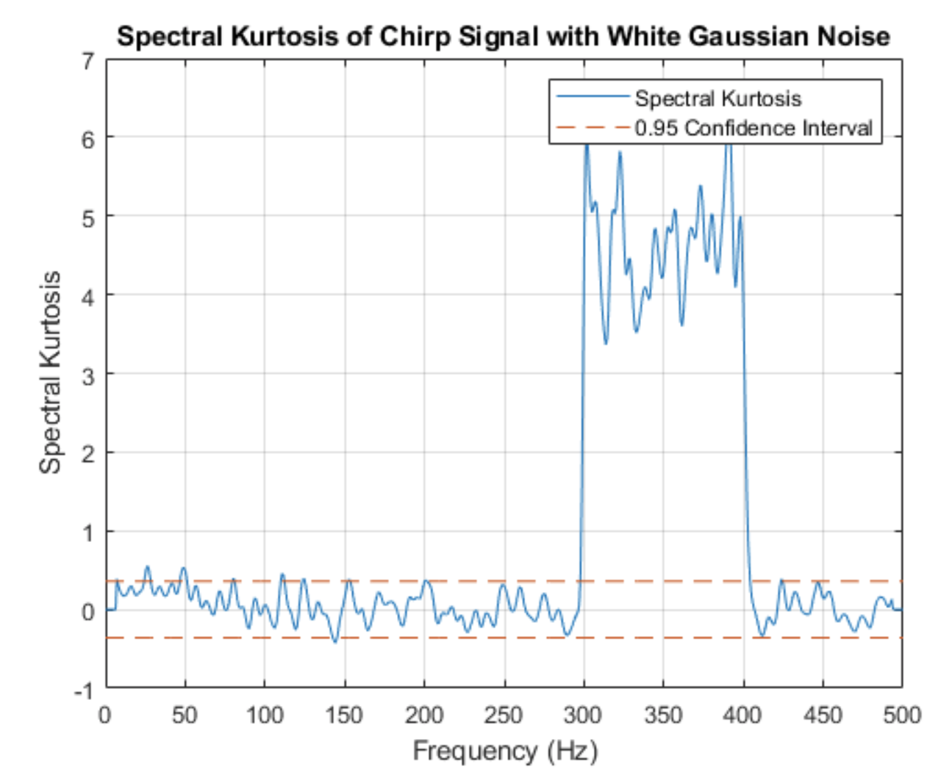
PAT02_FX_1D.pptx

